Slide 1
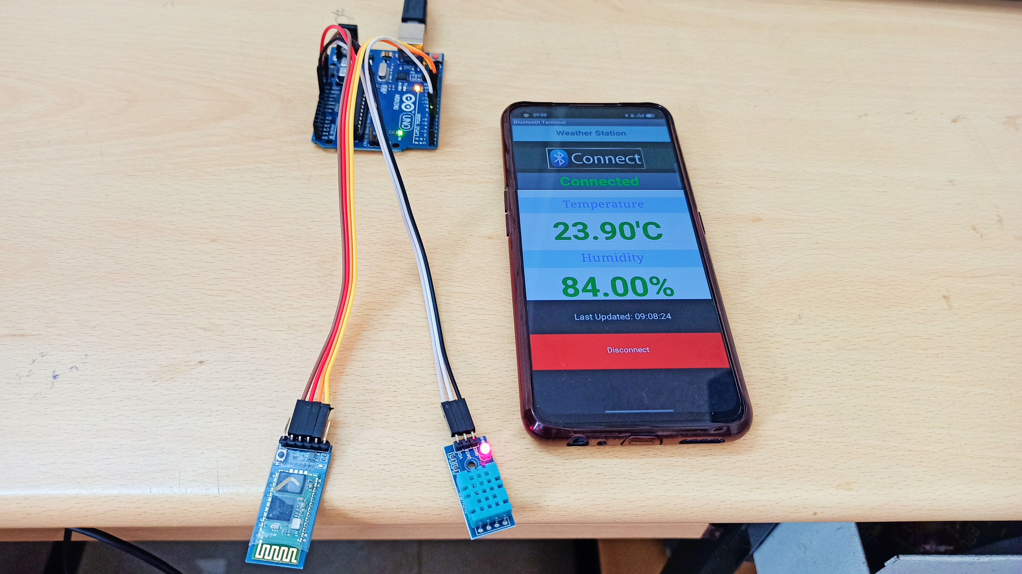
Wireless Temperature and Humidity Monitoring system

Slide 2
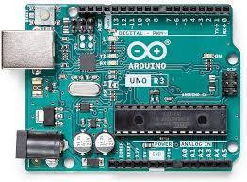
Arduino UNO R3
It is an ATmega328P based Microcontroller. The Operating Voltage of the Arduino is 5. Flash Memory -32 KB, and 0.5 KB memory is used by the boot loader. It comprises 14-digit I/O pins

Slide 3
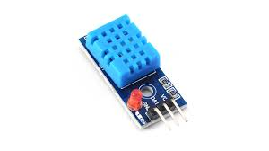
DHT11
The DHT11 is a commonly used Temperature and humidity sensor that comes with a dedicated NTC to measure temperature and an 8-bit microcontroller to output the value of temperature and humidity as serial data

Slide 4
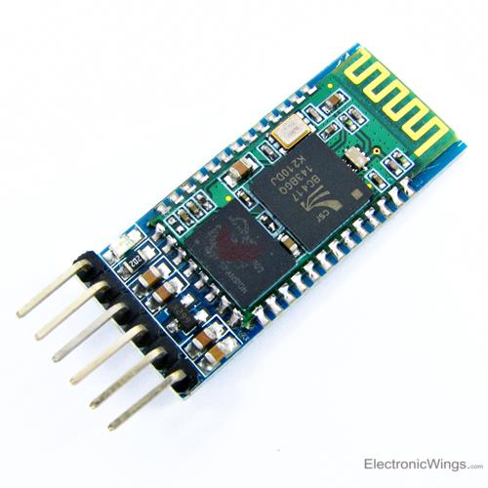
HC - 05
HC- 05 is Serial Bluetooth low energy module for microcontrollers operating at 4V – 6V. Works with serial communication and can operate is Master or Slave mode.

Slide 5
